Slide 1
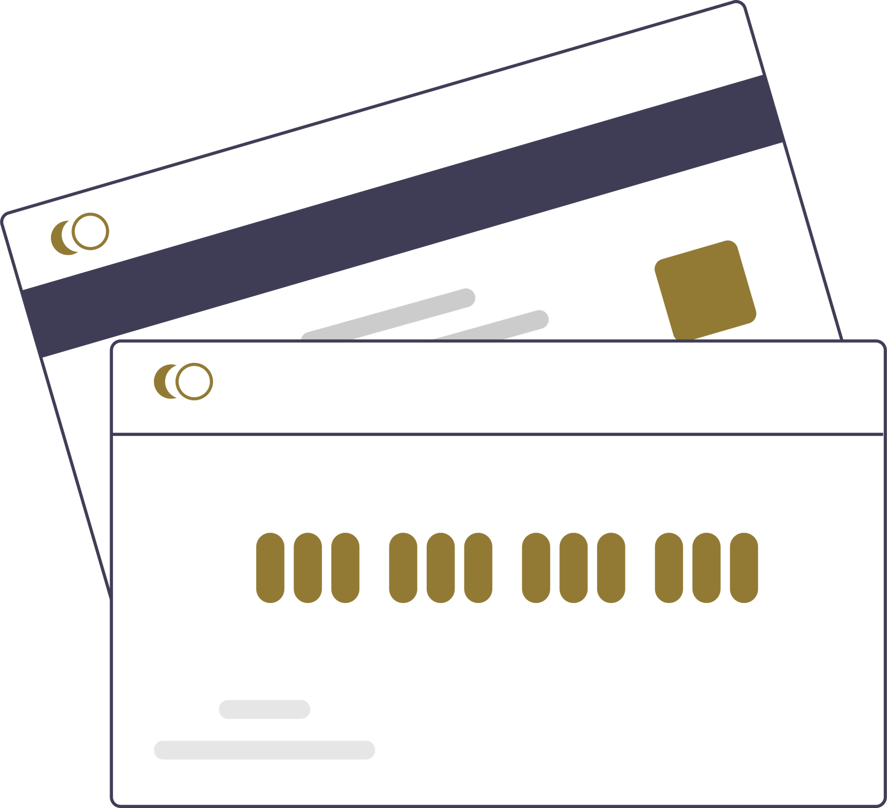


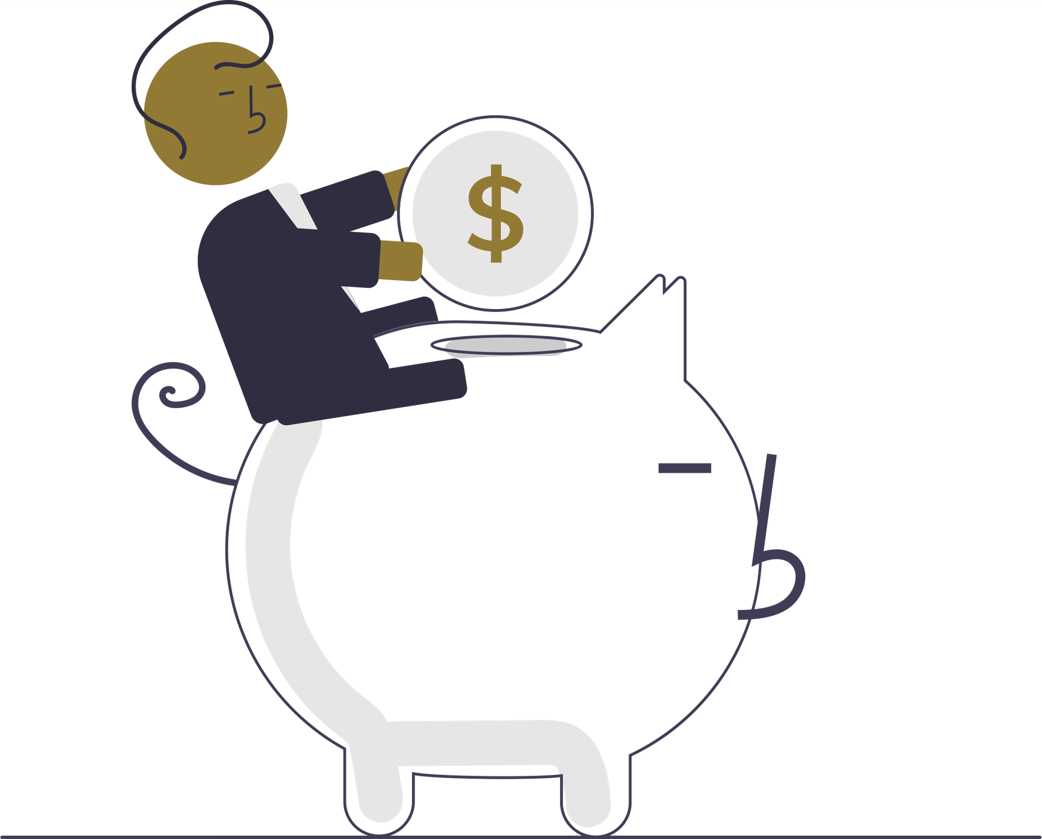
Budget Buddy
Abhishek Mathukiya - 002839155 Jilson Correia- 002695019
Heena Shah- 002788101
Soham Shah – 002837154
Kalash Desai- 002835211

Slide 2


TABLE OF CONTENTS
Overview
Target Audience
Product Objectives
User Pain Points
User Research Methods
Conclusion

Slide 3


Overview
Budget Buddy is a comprehensive personal finance app designed to help users effortlessly manage their budgeting, debt, and shared expenses. It tracks income and expenses automatically, categorizes transactions and provides real-time insights and alerts. With personalized financial recommendations, Budget Buddy simplifies debt management and bill splitting, empowering users to achieve economic stability and control at every stage of life.

Slide 4


Target Audience
Budget Buddy serves three key user groups with distinct financial needs:
Students
- Managing limited income, student loans, and shared expenses with roommates.
Working Professionals
- Handling regular income, bills, debt, and savings goals.
Retirees
- Focused on managing savings and retirement funds on a fixed income.
Summary: Budget Buddy offers personalized financial solutions for users at different life stages—helping students, professionals, and retirees achieve financial control and stability.
Notes:
Students - Need help with budgeting and tracking spending. Working - Seek automated tools to manage expenses and get real-time financial insights.
Retirees - Need accessible tools to track finances and maintain control over spending.

Slide 5

PRODUCT OBJECTIVES
1.Simplify Budgeting:
Provide users with an easy-to-use tool to track and categorize expenses automatically, helping them manage their finances effortlessly.

Slide 6


PRODUCT OBJECTIVES
2. Optimize Debt Management:
Help users track multiple debts, set repayment schedules, and offer personalized strategies to reduce debt faster.

Slide 7

PRODUCT OBJECTIVES
3. Enable Shared Expense Management:
Allow seamless bill splitting and tracking of shared expenses with friends, roommates, or family.

Slide 8
PRODUCT OBJECTIVES
4. Provide Real-Time Financial Insights:
Offer users actionable insights and alerts to ensure they stay within their budgets and reach financial goals.

Slide 9
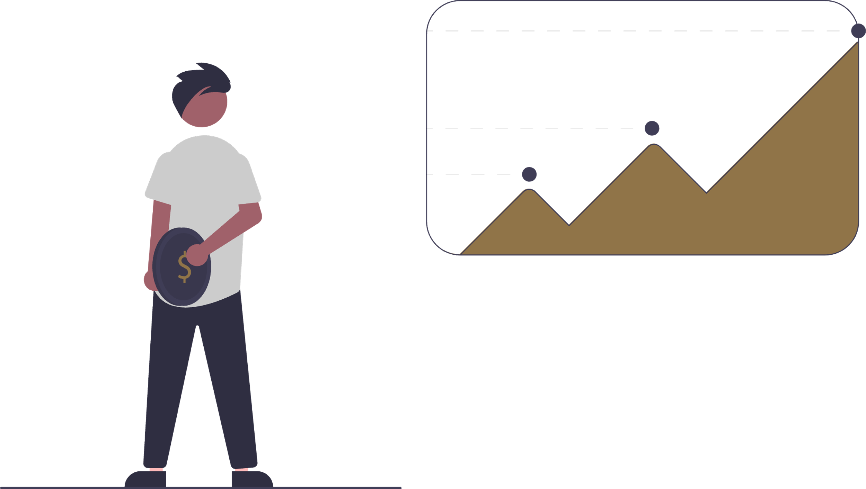
PRODUCT OBJECTIVES
5. Support Long-Term Savings Goals:
Help users set and track savings goals, providing recommendations on cutting expenses to meet their financial objectives.

Slide 10
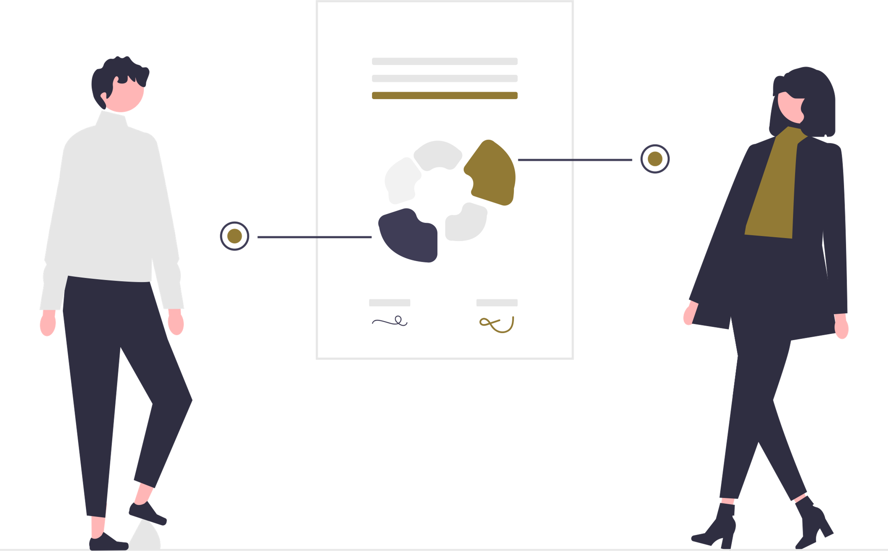
USER PAIN POINTS
Difficulty Tracking Expenses: The struggle with manually tracking and categorizing expenses.
Managing Multiple Debts: Keeping track of loans and credit card payments is overwhelming.
Complicated Shared Expense Management: Managing and splitting bills with friends or colleagues.
Overspending Without Realizing: Lack of real-time alerts to prevent overspending.
Balancing Debt Repayment and Savings: Difficulty to allocate funds.
Lack of Personalization: Users often feel financial apps provide generic recommendations.
Overwhelming Data Presentation: Users can get lost in overly complex financial data.

Slide 11
Personas

Slide 12
Persona Creation
Reason for Choosing
Understanding user needs and behaviors is crucial in developing a finance app that stands out in the market. Persona Creation, a renowned user research method, offers detailed insights into the diverse user base, allowing developers to design a more tailored and effective app.
Overview
Persona Creation is a qualitative research method that involves crafting fictional yet realistic user profiles based on actual data and research. These personas embody the characteristics, needs, goals, and observed behavior patterns of larger segments of your target audience. By embodying users in this way, developers and designers can better empathize and understand the challenges and needs of their user base.

Slide 13
Needs of Persona Creation
1. Targeted Development: By understanding specific user types, developers can make more informed decisions, ensuring that features align with genuine user needs.
2. Enhanced User Experience (UX): Crafting personas can lead to a more user-centric design, resulting in a smoother and more intuitive user experience.
3. Effective Marketing: Understanding user segments through personas can guide more targeted and effective marketing campaigns.
4. Prioritizing Features: Knowing the goals and challenges of each persona helps in prioritizing which features or improvements are most essential.
Benefits of Persona Creation
Informed Decision-Making: Personas provide clarity and direction, helping in making informed decisions throughout the app's development and lifecycle.
2. Resource Allocation: With a clear understanding of user needs, resources can be allocated more efficiently, focusing on high-impact areas.

Slide 14
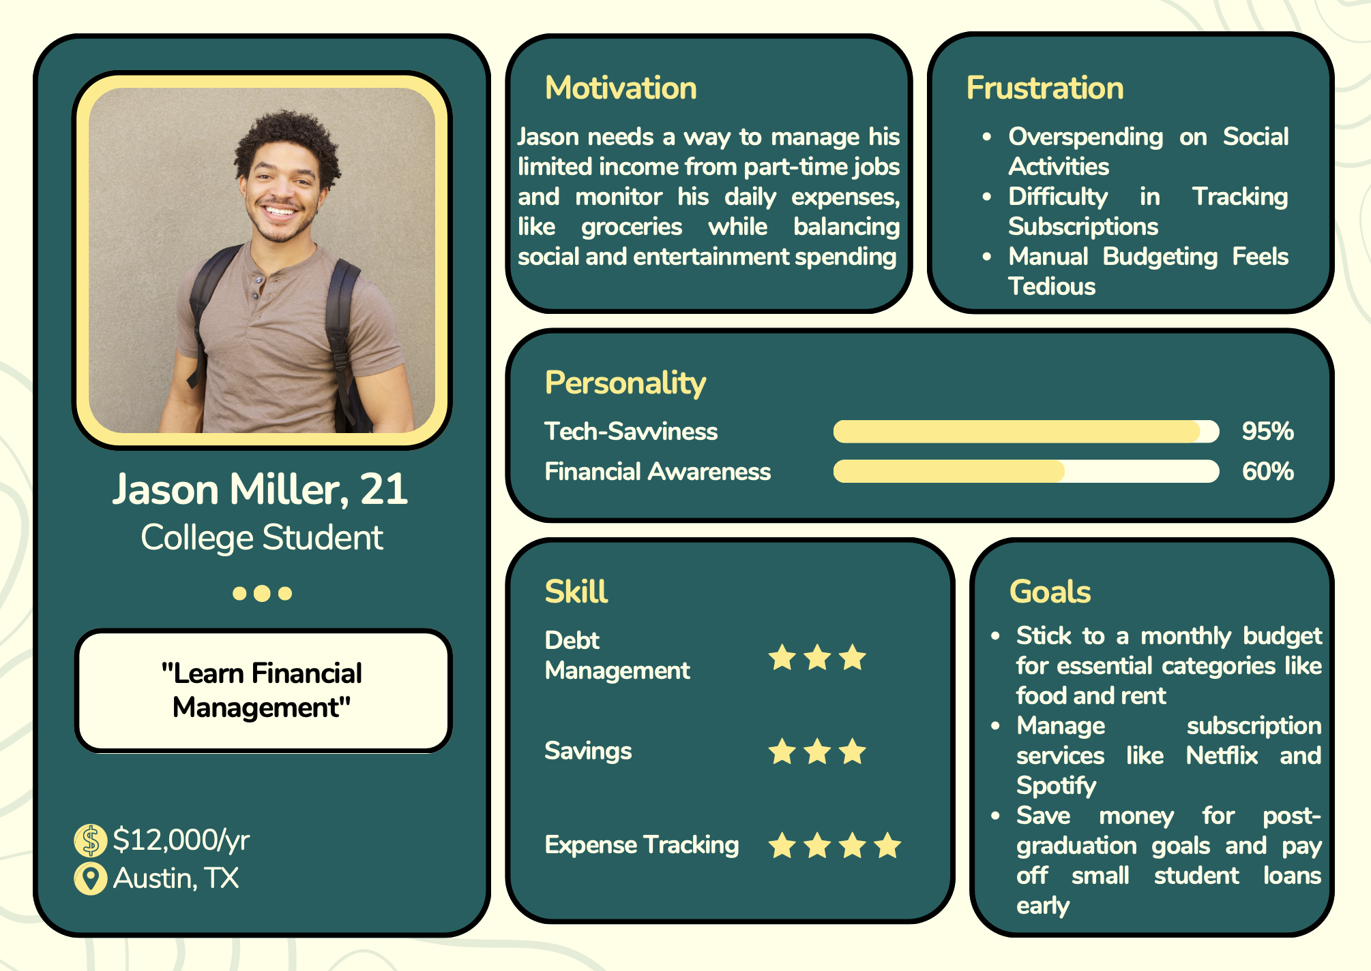
Personas

Slide 15
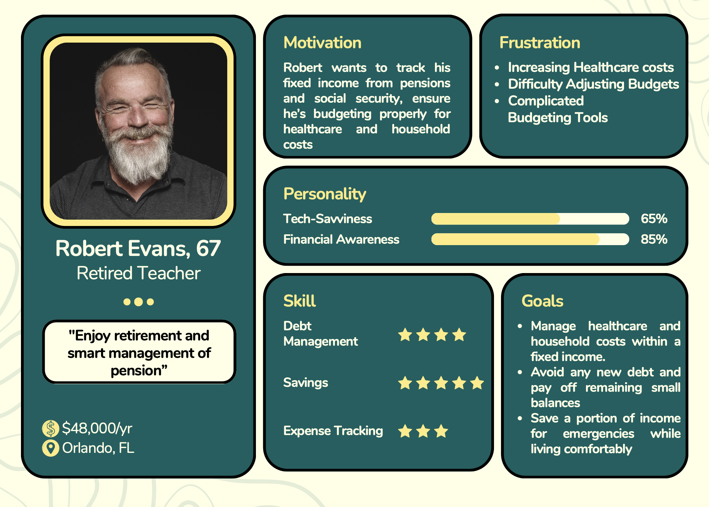
Personas

Slide 16
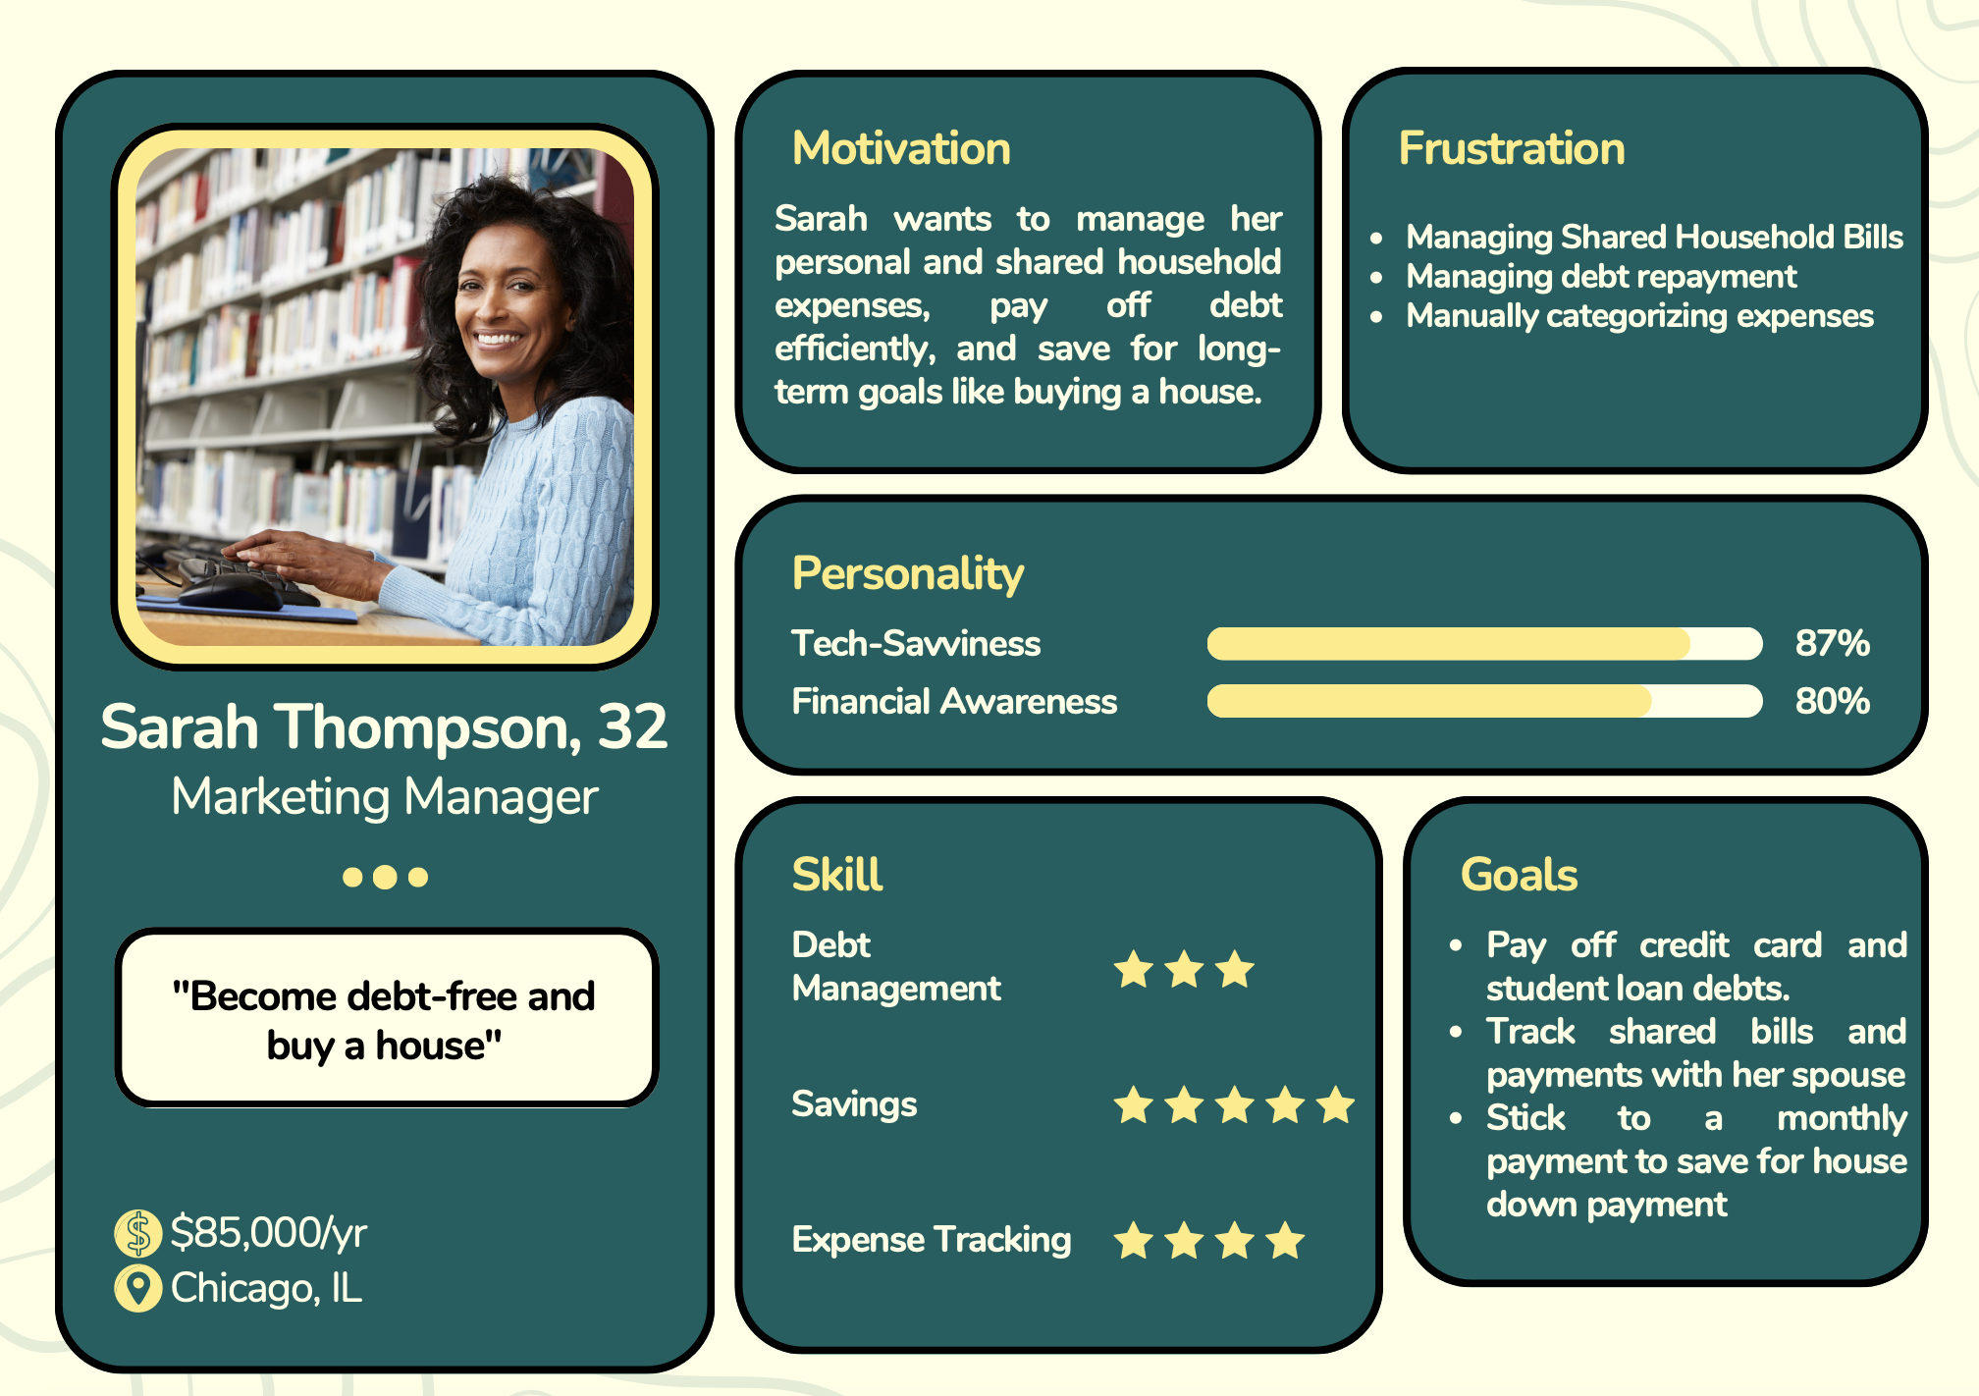
Personas

Slide 17
SWOT ANALYSIS
Reason for Choosing
SWOT is a powerful tool to uncover hidden strengths and weaknesses.
It provides a strategic view to capitalize on opportunities and guard against threats.
Overview
We systematically analyze internal strengths and weaknesses to refine the user experience.
External opportunities and market threats are identified to sharpen our competitive edge.

Slide 18
Needs of SWOT Analysis
Identify Strengths
Pinpoint Weaknesses
Explore Opportunities
Mitigate Threats
Benefits of SWOT Analysis
Strategic Planning
Opportunity Recognition
User-Centered Improvement
Risk Management

Slide 19
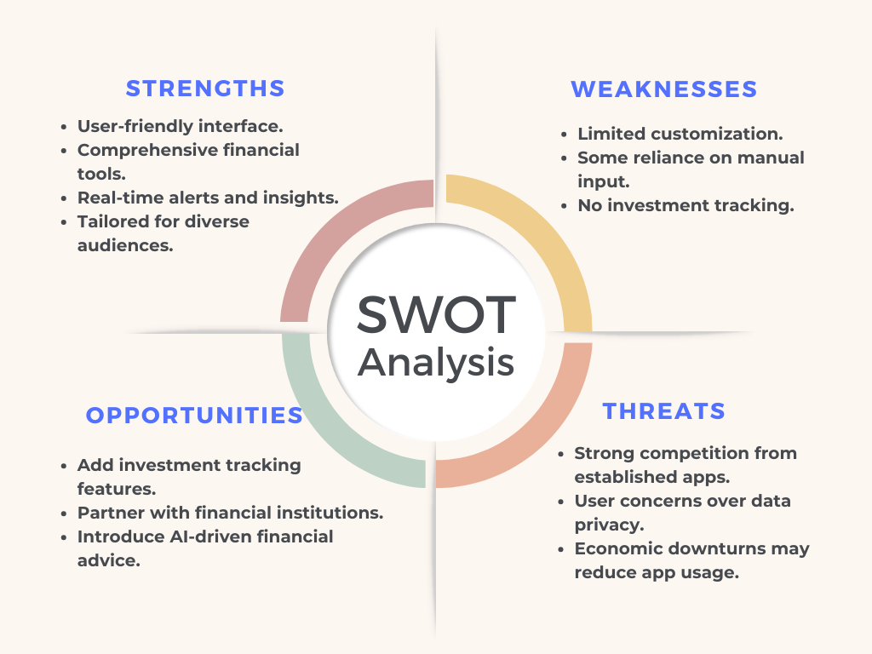

Slide 20
User Journey Maps
Reason for Choosing
Visualize Flow
Identify Issues
Enhance Engagement
Overview
Map Actions
Track Emotions
Analyze Touchpoints
Benefits
Smoother Onboarding
Enhance Usability
Boost Loyalty
Needs
Optimize Flow
Boost Satisfaction
Increase Retention
Notes:
Reason: Visualize Flow: Understand user interactions from onboarding to daily use. Identify Issues: Discover points of friction or confusion. Enhance Engagement: Focus on areas of high user engagement to boost retention. Overview: Map Actions: Track user interactions at every stage (onboarding, tracking, debt management).
Track Emotions: Capture user emotions during key moments.
Analyze Touchpoints: Identify key interactions and potential bottlenecks.
Needs Optimize Flow: Streamline the user journey by addressing friction.
Boost Satisfaction: Improve emotional experience and reduce frustration.
Increase Retention: Focus on areas where users disengage to reduce drop-offs.
Benefits
Smoother Onboarding: Eliminate barriers to create a seamless entry.
Enhance Usability: Ensure key features are easy to use.
Boost Loyalty: Solve pain points to improve user experience and loyalty.

Slide 21
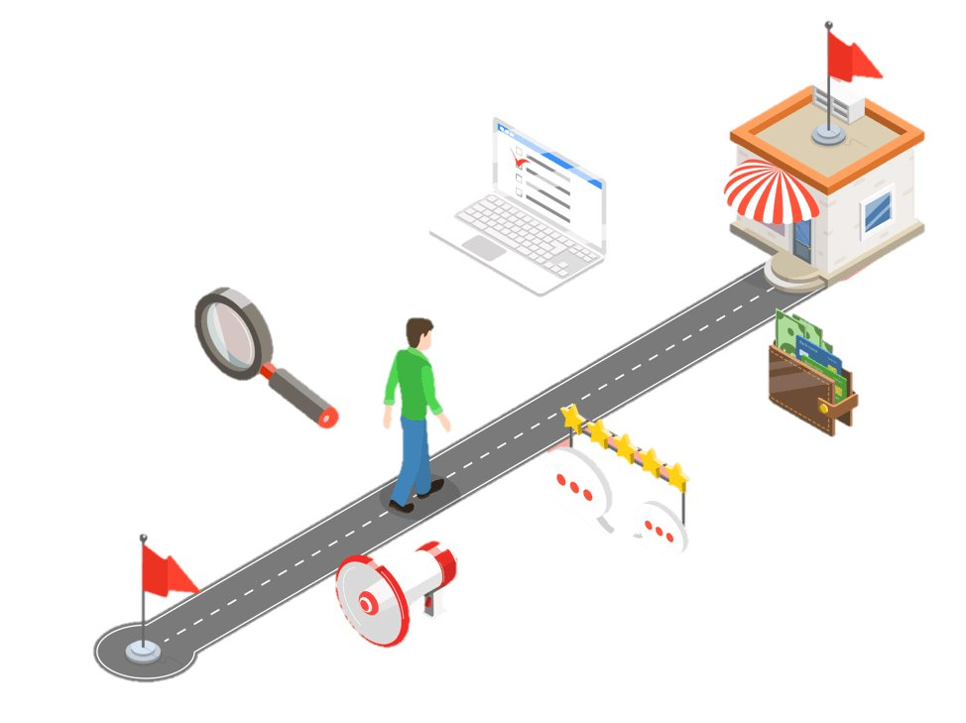
Journey Map
Awareness
This is where users first hear about Budget Buddy through:
- Social media (e.g., Instagram, Facebook)
- Search engines (Google)
- Referrals from friends or financial blogs
- Advertisements on apps like YouTube or other finance platforms
User Actions:
Users become aware that Budget Buddy exists, and they are curious about its features.
They are looking for solutions for tracking their finances, paying off debts, and budgeting.
Touchpoints:
Social media ads, app store search, word of mouth.

Slide 22

2. Consideration
Now that users are aware of Budget Buddy, they begin researching:
Users compare Budget Buddy with apps like Mint or Splitwise.
They read reviews and blog recommendations.
They visit the other websites or app store page for more details.
User Actions:
They might download the free version to explore features and see if it aligns with their financial goals.
Touchpoints:
App store reviews, website, comparison blogs, YouTube demos.

Slide 23
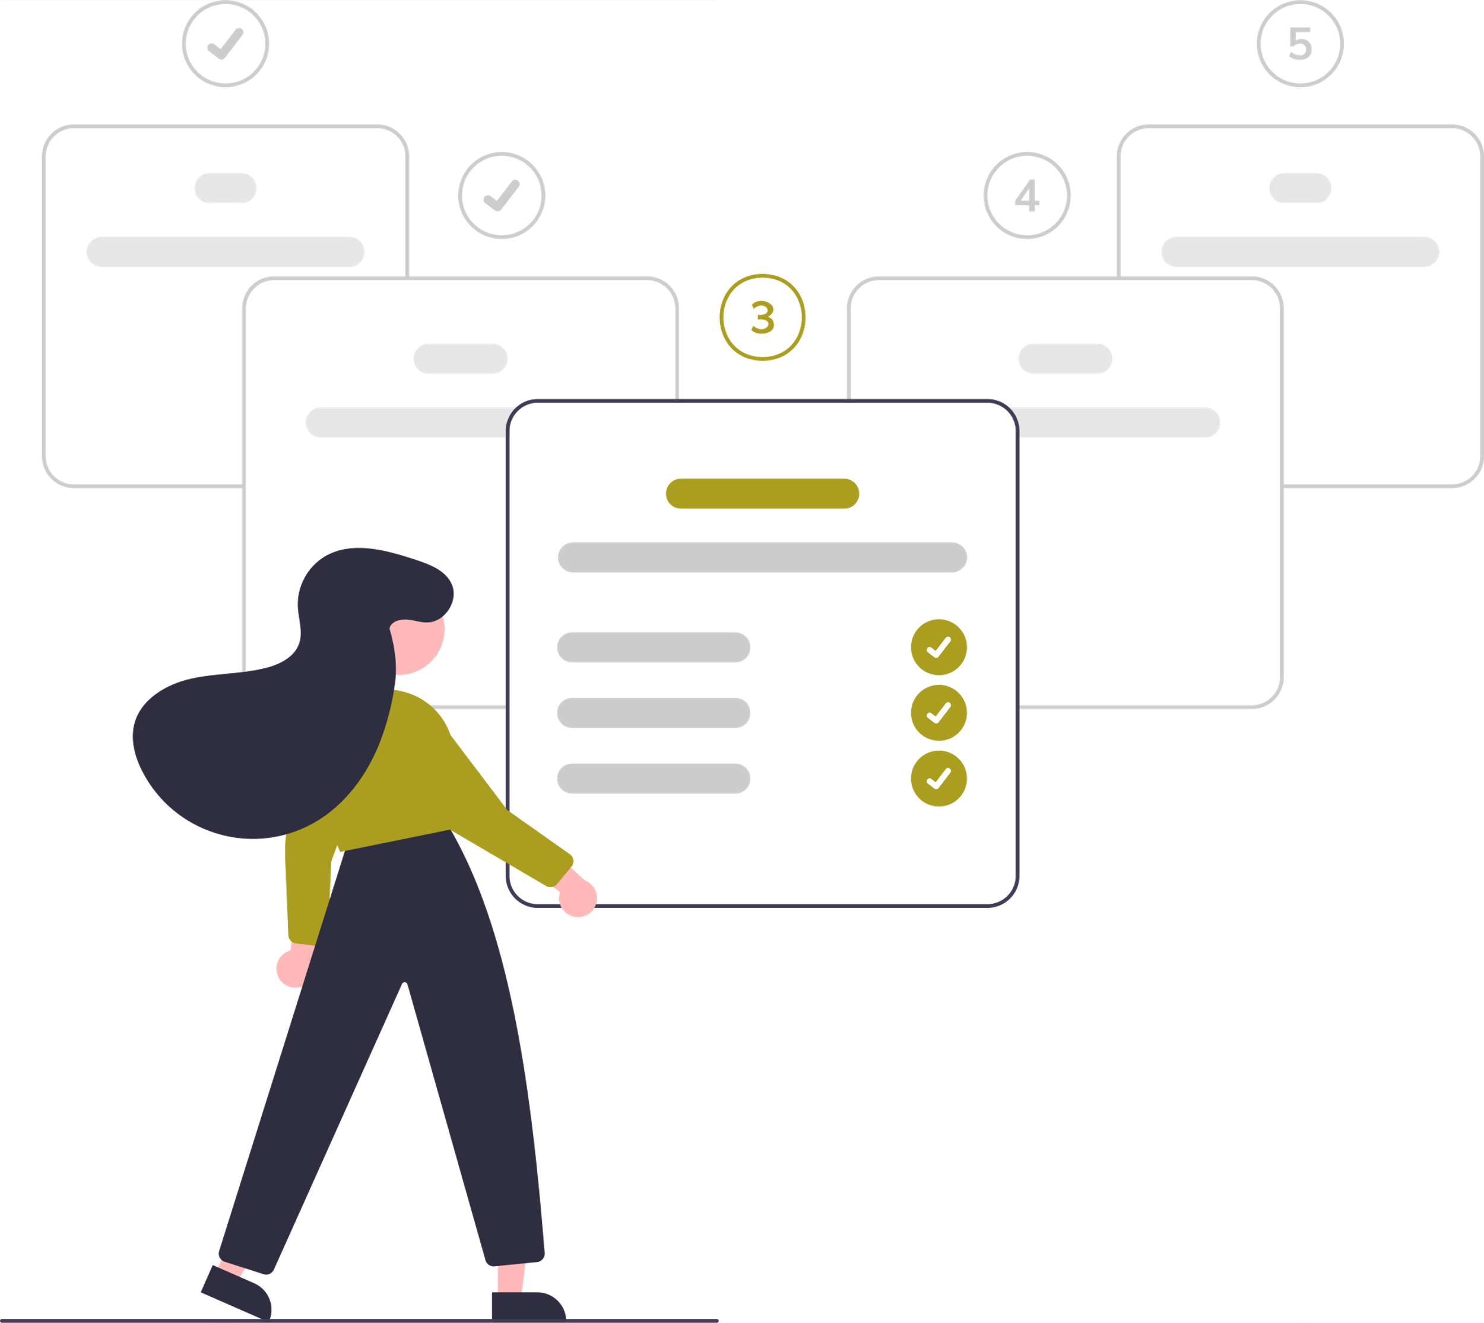
3. Purchase/Sign-Up
Users decide to move forward:
Users sign up for Budget Buddy, choosing either the free version or upgrading to premium features like advanced debt management and personalized insights
User Actions:
They complete sign-up, link bank accounts, set budgets, and enter debts. Users then explore the dashboard to track expenses and manage bills.
Touchpoints:
Sign-up page, onboarding walkthrough, email confirmations.

Slide 24
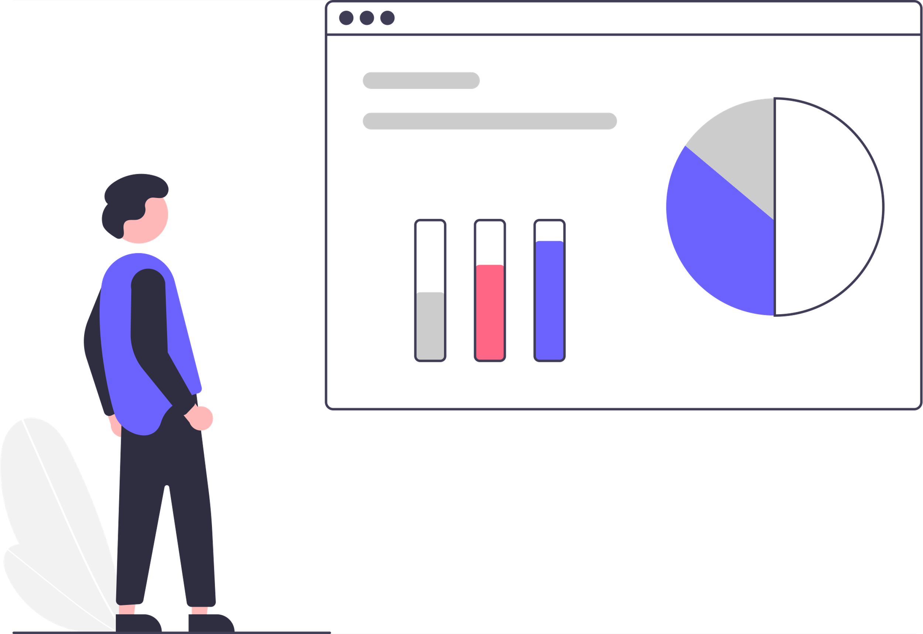
4. Engagement
Once onboarded, users actively engage with the app:
Users set up budgets, track spending, and adjust financial goals based on app insights.
They get notifications for overspending and bill payment reminders, along with personalized tips for saving and debt repayment.
User Actions:
Regularly logging in to check finances, using features like bill splitting, automated tracking, and managing shared expenses.
Touchpoints:
In-app notifications, budgeting tools, transaction history, personalized reports.

Slide 25
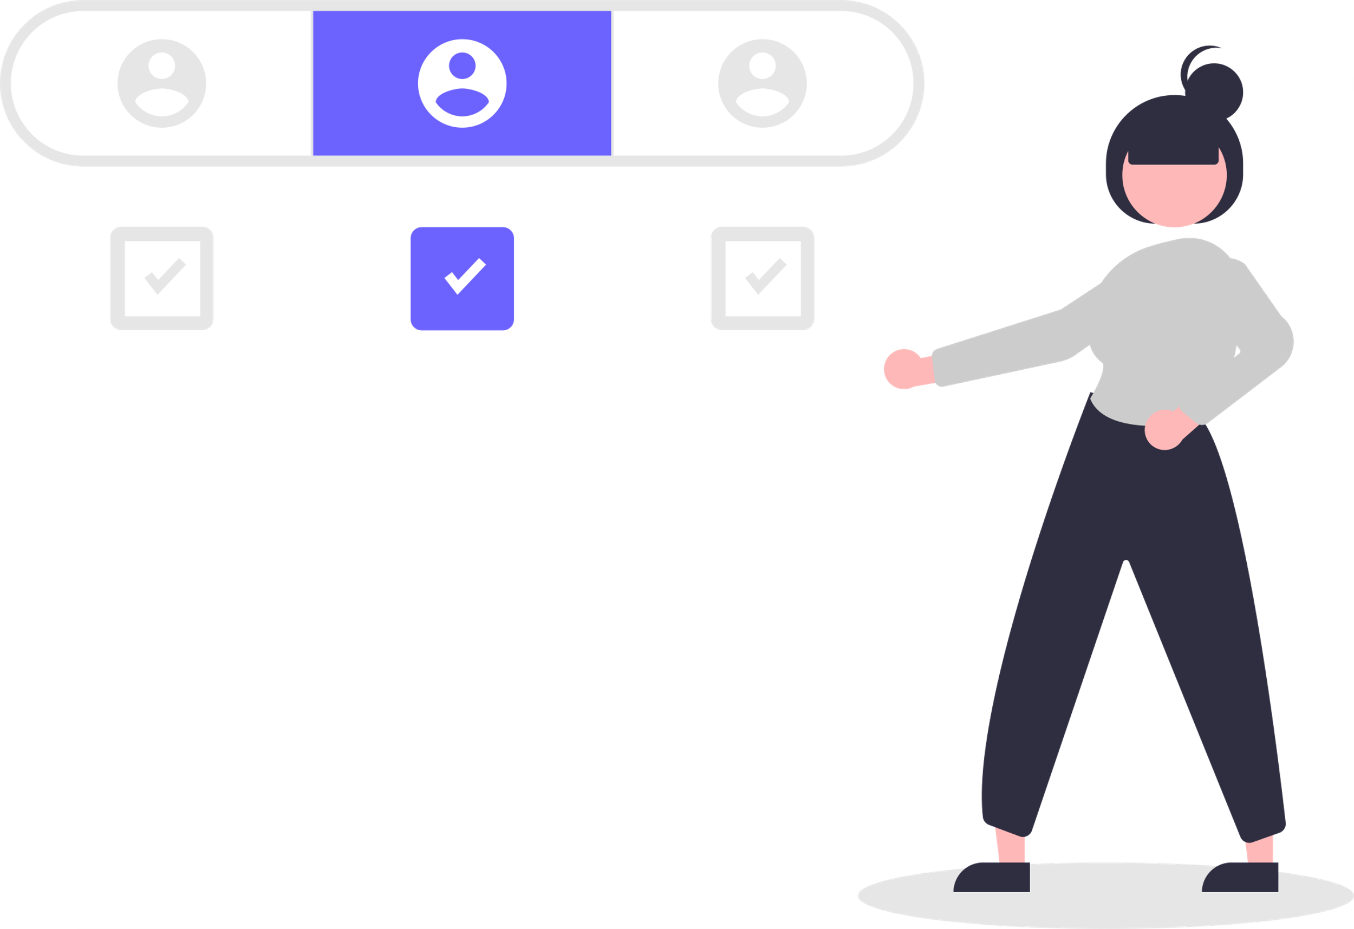

5. Retention/Renewal
If the app meets users' needs:
If satisfied, users renew their premium subscription and continue using Budget Buddy for long-term financial planning, debt management, and savings.
They may also recommend the app to others, becoming advocates.
User Actions:
Subscribing to a long-term premium plan and consistently using the app to manage finances and future goals.
Touchpoints:
Email updates, subscription renewal reminders, loyalty rewards, referral incentives.

Slide 26
CONCLUSION
Simplifying Personal Finance: - Budget Buddy empowers users to manage their budget, debt, and shared expenses with ease.
User-Centric and Adaptable: - Designed for students, professionals, and retirees with personalized insights for each stage of life.
Real-Time Financial Clarity: - Real-time alerts and recommendations ensure smarter financial decisions for users.
Future Growth and Innovation: - Continuous improvements like investment tracking and AI-driven advice will enhance the user experience.

Slide 27
REFERENCES
UX Research (Nielsen Norman Group): Visualizes user touchpoints to identify pain points and opportunities
SWOT Analysis: Evaluates Strengths, Weaknesses, Opportunities, and Threats in product development.
Mint: Personal finance tracking, real-time budget insights, investment monitoring.
Splitwise: Simplifies shared expenses, optimized for group payments.
MaxRewards: Credit card reward maximization, tracking offers and benefits.
Apple Pay / PayPal / Zelle / Venmo: Secure, easy payment solutions, strong adoption in peer-to-peer transfers.
Personal Finance Apps: Increasing user adoption, focus on financial wellness and budgeting tools.

Slide 28
THANK YOU !

